Slide 1
Predictive Modeling & Forecasting / Anomaly Detection
SINGLE WORKER NEHA PATHAK VEDANSHU JOSHI
PRESENTER:
NEHA PATHAK
DATE:
02/07/2025
DEPARTMENT:
COMPUTER SCIENCE

Slide 2
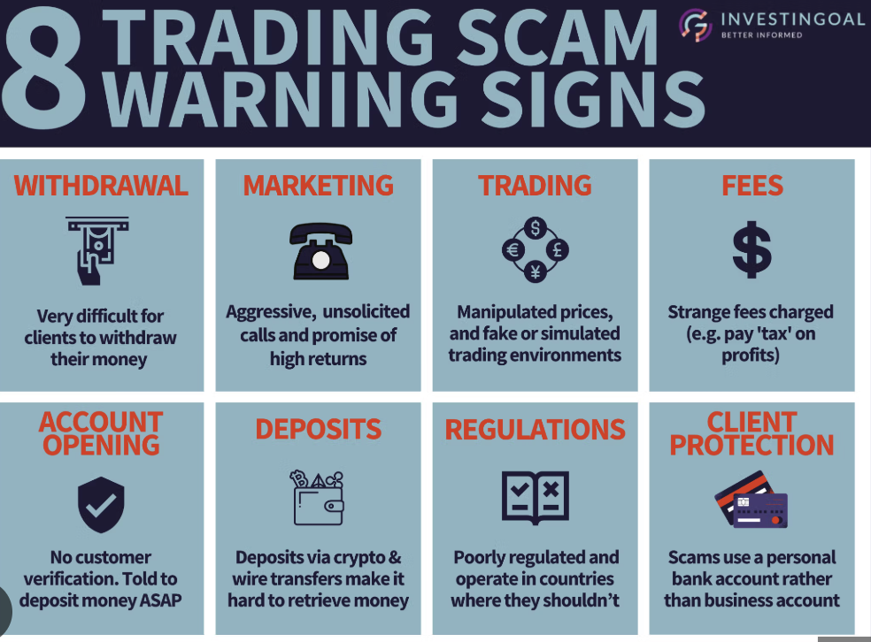
Before the 2008 financial crisis, many risky financial deals (like derivatives) were made without clear records or oversight. When the crisis hit, regulators had no clear picture of how much risk was actually in the system, making it hard to respond quickly and prevent a collapse

Slide 3
The Unsolved Problem: Data is Messy!
Global Financial Market Data Harmonization
Even though financial firms are now reporting more data, the problem is that different countries and markets use different formats, rules, and definitions when collecting this data. This makes it hard to combine everything into a single, clear picture for regulators.
For example:
The U.S. might record a trade as "Interest Rate Swap", while the EU calls it "Fixed-to-Floating Agreement."
Some regulators require detailed breakdowns, while others just need summary numbers.
Different reporting systems use different identifiers for the same financial instruments.

Slide 4
Challenges
Inconsistent data formats across exchanges
Different financial reporting standards
Lack of real-time risk assessment tools
Difficulties in cross-border data sharing
Data Fragmentation: Multiple currencies, inconsistent market timestamps
Regulatory Burden: Lack of standard identifiers (CUSIP, ISIN, SEDOL)
Risk Management Gaps: Inability to detect anomalies in real time.
Compliance Issues: Different jurisdictions impose unique regulations.

Slide 5
Proposed Machine Learning Solution
Data Collection & Preprocessing
Sources: Market data from global exchanges.
Key Preprocessing Steps:
Convert date formats and sort transactions.
Compute moving averages, volatility, and RSI.
Standardize price, volume, and returns for ML models
LSTM for sequential trend prediction
Traditional ML models (RF, XGBoost, SVR, GBR) for trend forecasting
Isolation Forest for anomaly detection and risk management

Slide 6
Technical Implementation
Tech Stack Overview:
Python with key libraries: Pandas, NumPy
ML frameworks: TensorFlow/Keras (LSTM),
Scikit-learn, XGBoost
Visualization: Matplotlib, Seaborn
Environment: Kaggle Notebooks
Architecture Diagram:
4-Layer Architecture:
Data Ingestion (Kaggle dataset input)
Feature Engineering (Technical indicators)
Model Processing (LSTM & ML models)
Analysis Output (Metrics & Visualization)
Data Usage:
Source: Kaggle Stock Exchange Data dataset
Preprocessing: Data cleaning, normalization
Feature Engineering: RSI, MACD, Bollinger Bands, Moving Averages
AI Considerations: Regular validation, bias monitoring, cross-validation
Model Performance and Results:
Model Accuracy:
LSTM: 86%
Random Forest: 83%
XGBoost: 85%

Slide 7
Industry Impact, Collaboration and Production Viability
Potential Path to Production:
Phase 1: Docker containerization for easy deployment
Phase 2: CI/CD pipeline using Jenkins/GitHub Actions
Phase 3: Cloud deployment (AWS/Azure) for scalability
Phase 4: API development for external integrations
Phase 5: Monitoring setup using Grafana/Prometheus
Scalability at Enterprise Level:
Distributed processing using Apache Spark
Load balancing for high-volume data processing
Auto-scaling based on market activity
Real-time data processing capabilities
Data storage optimization using data lakes
Collaboration with Industry Partners:
Used publicly available Kaggle dataset
Potential for future partnerships with:
Financial institutions
Market data providers
Regulatory bodies
Open for community feedback and contributions
Challenges and Limitations:
Technical Challenges:
Real-time data processing latency
Model retraining requirements
Data storage costs
Business Limitations:
Market volatility impact
Limited historical data
Regulatory compliance needs
Resource-intensive computations

Slide 8
Demo
Key Functionalities:
Data Analysis & Prediction
Automated market data processing
Real-time technical indicator calculations
Multi-model prediction system
Anomaly detection for unusual market patterns
Risk Management
Volatility tracking and alerts
Performance metric monitoring
Market trend analysis
Risk level assessment using multiple indicators
Reporting & Visualization
Automated report generation
Interactive dashboards
Custom alert systems
Technical analysis charts
User Experience:
Interface Design
Clean, intuitive dashboard layout
Interactive visualization tools
Real-time data updates
Mobile-responsive design
Ease of Use
One-click report generation
Customizable dashboard views
Drag-and-drop data import
User-friendly configuration options
Innovative Features
AI-powered market insights
Automated alert system
Custom indicator creation
Multi-device synchronization
Export functionality in multiple formats

Slide 9
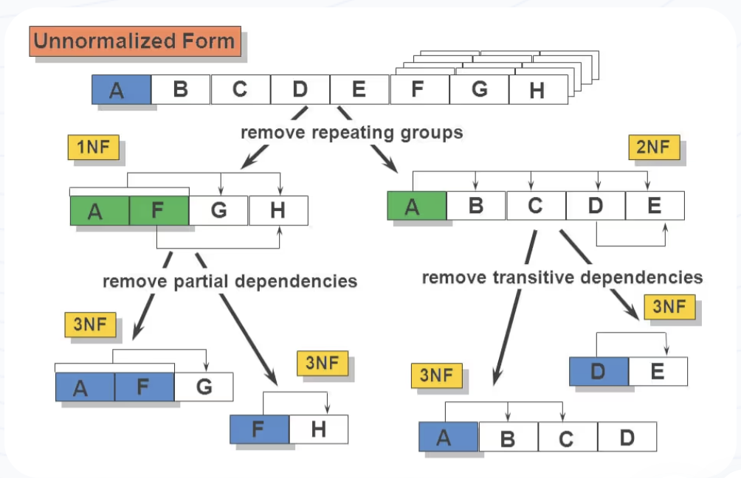
Conclusion
"Our solution transforms complex global financial data into actionable insights using advanced machine learning. By harmonizing data across multiple markets and providing real-time analysis, we enable better decision-making and risk management for financial institutions. With 86% prediction accuracy and comprehensive technical analysis, our platform sets a new standard for market intelligence."

Slide 10
Appendix
Returns: Percentage change in closing price from the previous day.
Log_Returns: Logarithmic return based on the closing price.
Moving Averages (MA5, MA20, MA50): Simple moving averages for 5, 20, and 50 days.
Volatility: Rolling standard deviation of returns over 20 days, representing price fluctuations.
RSI (Relative Strength Index): Measures the magnitude of recent price changes to evaluate overbought/oversold conditions (14-day window).
MACD (Moving Average Convergence Divergence): Difference between 12-day and 26-day exponential moving averages, used for trend analysis.
Bollinger Bands: Upper and lower bands that show the range of expected price movement (based on 20-day moving average and standard deviation).
Volume_MA: 20-day moving average of trade volume.
Volume_Rate: Ratio of current trading volume to the 20-day volume moving average, indicating unusual activity.

